Slide 1
GREEN FINANCE
Advancing Higher Education for Sustainable Growth in Southeast Asia
Project number: 101237817
Work Package 5
Dissemination & Sustainability
In-person Kick-off Meeting
22 January 2026 – Sibiu, Romania
Presented by: IHF & PU

Slide 2
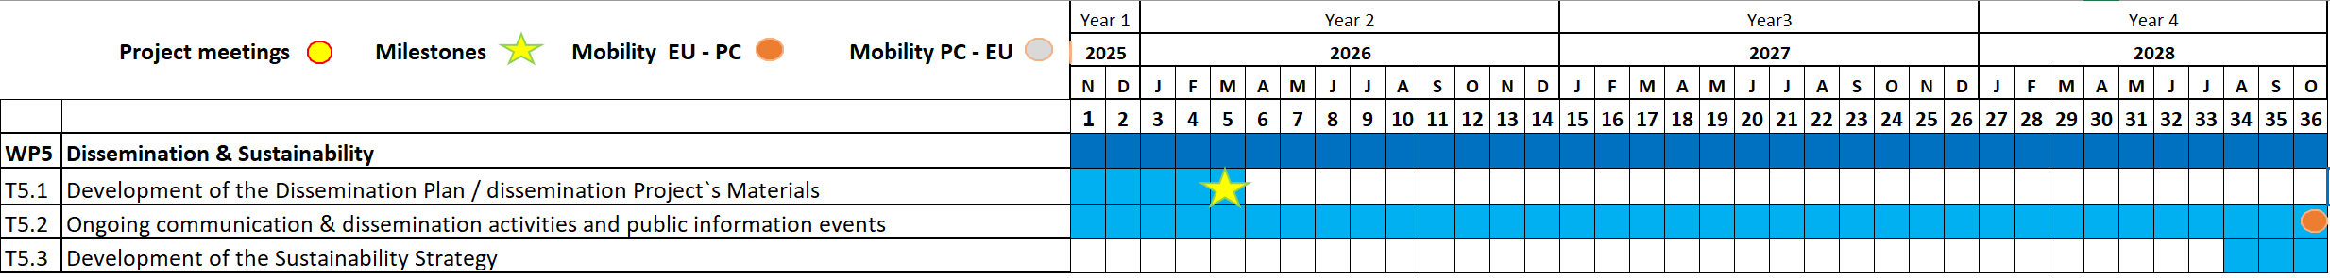
WP5 Timeline and deliverables
Work Package No | Deliverable Related No | Deliverable Name | Lead Beneficiary | Due Date
WP5 | D5.1 | Dissemination Plan and materials | PAYAP | 31 Mar 2026
WP5 | D5.2 | Project website | PAYAP | 31 Mar 2026
WP5 | D5.3 | Dissemination mid-term report | PAYAP | 30 Apr 2027
WP5 | D5.4 | Dissemination final report | PAYAP | 31 Oct 2028
WP5 | D5.5 | Sustainability Strategy | PAYAP | 31 Oct 2028
Funded by the European Union. Views and opinions expressed are however those of the author(s) only and do not necessarily reflect those of the European Union or Erasmus+.
Neither the European Union nor the granting authority can be held responsible for them

Slide 3
An overview of dissemination – key elements
Sharing & Promotion strategy will be presented here and outlined in the Dissemination Plan, to be shared by PU & IHF by M5 – the plan will provide for key coordinates to which all partners can rely on to plan internally their communication strategies and outreach of target groups and stakeholders. Work in progress – draft version available
Dissemination is an on-going activity, covering the entire duration of the project (and even beyond) – formal and fine-tuned dissemination activities will be carried out in conjunction to completion of major project’s milestones (i.e., online publication of WPs’ deliverables, TPMs, events, etc.)
Please, when reporting your data in the Dissemination Reporting Tool consider the potential outreach / visibility of your communication rather than mere reactions – the fact that people is not interacting with your communication does not mean that they did not see it
Partners are recommended to draft, consolidate (and update on a need basis) a stakeholders’ list with contacts of APs, stakeholders and policymakers operating at local-regional/national/int.l level
Funded by the European Union. Views and opinions expressed are however those of the author(s) only and do not necessarily reflect those of the European Union or Erasmus+.
Neither the European Union nor the granting authority can be held responsible for them

Slide 4
Communication vs. Dissemination
Target - WHO
General public
Target - WHO
Project target groups
Stakeholders
Decision Makers
Content - WHAT
News of the project, progresses’ updates, promotion of project events, etc.
Communication
Content - WHAT
Project results
Dissemination
Timing - WHEN
Throughout the entire project and beyond
Timing - WHEN
Anytime and as soon as there are activities and results that are relevant
Purpose - WHY
Spread the News
Give visibility to the project
Generate interest
Create “demand” for results
Purpose - WHY
Make project results public
Funded by the European Union. Views and opinions expressed are however those of the author(s) only and do not necessarily reflect those of the European Union or Erasmus+.
Neither the European Union nor the granting authority can be held responsible for them

Slide 5
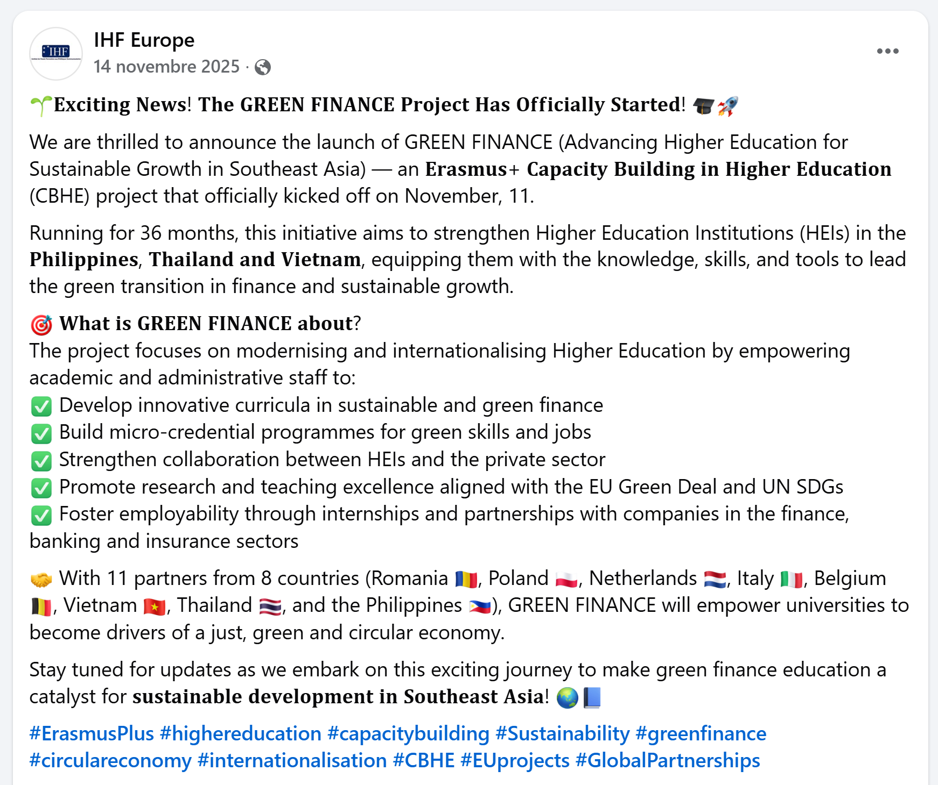
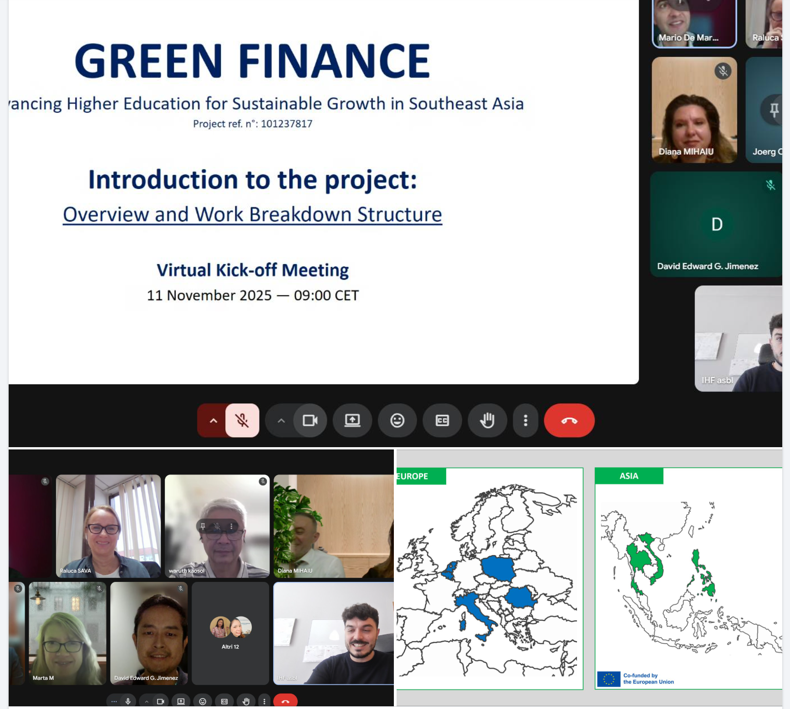
Communication example
SOCIAL MEDIA POST FOR THE GREEN FINANCE PROJECT
Funded by the European Union. Views and opinions expressed are however those of the author(s) only and do not necessarily reflect those of the European Union or Erasmus+.
Neither the European Union nor the granting authority can be held responsible for them

Slide 6
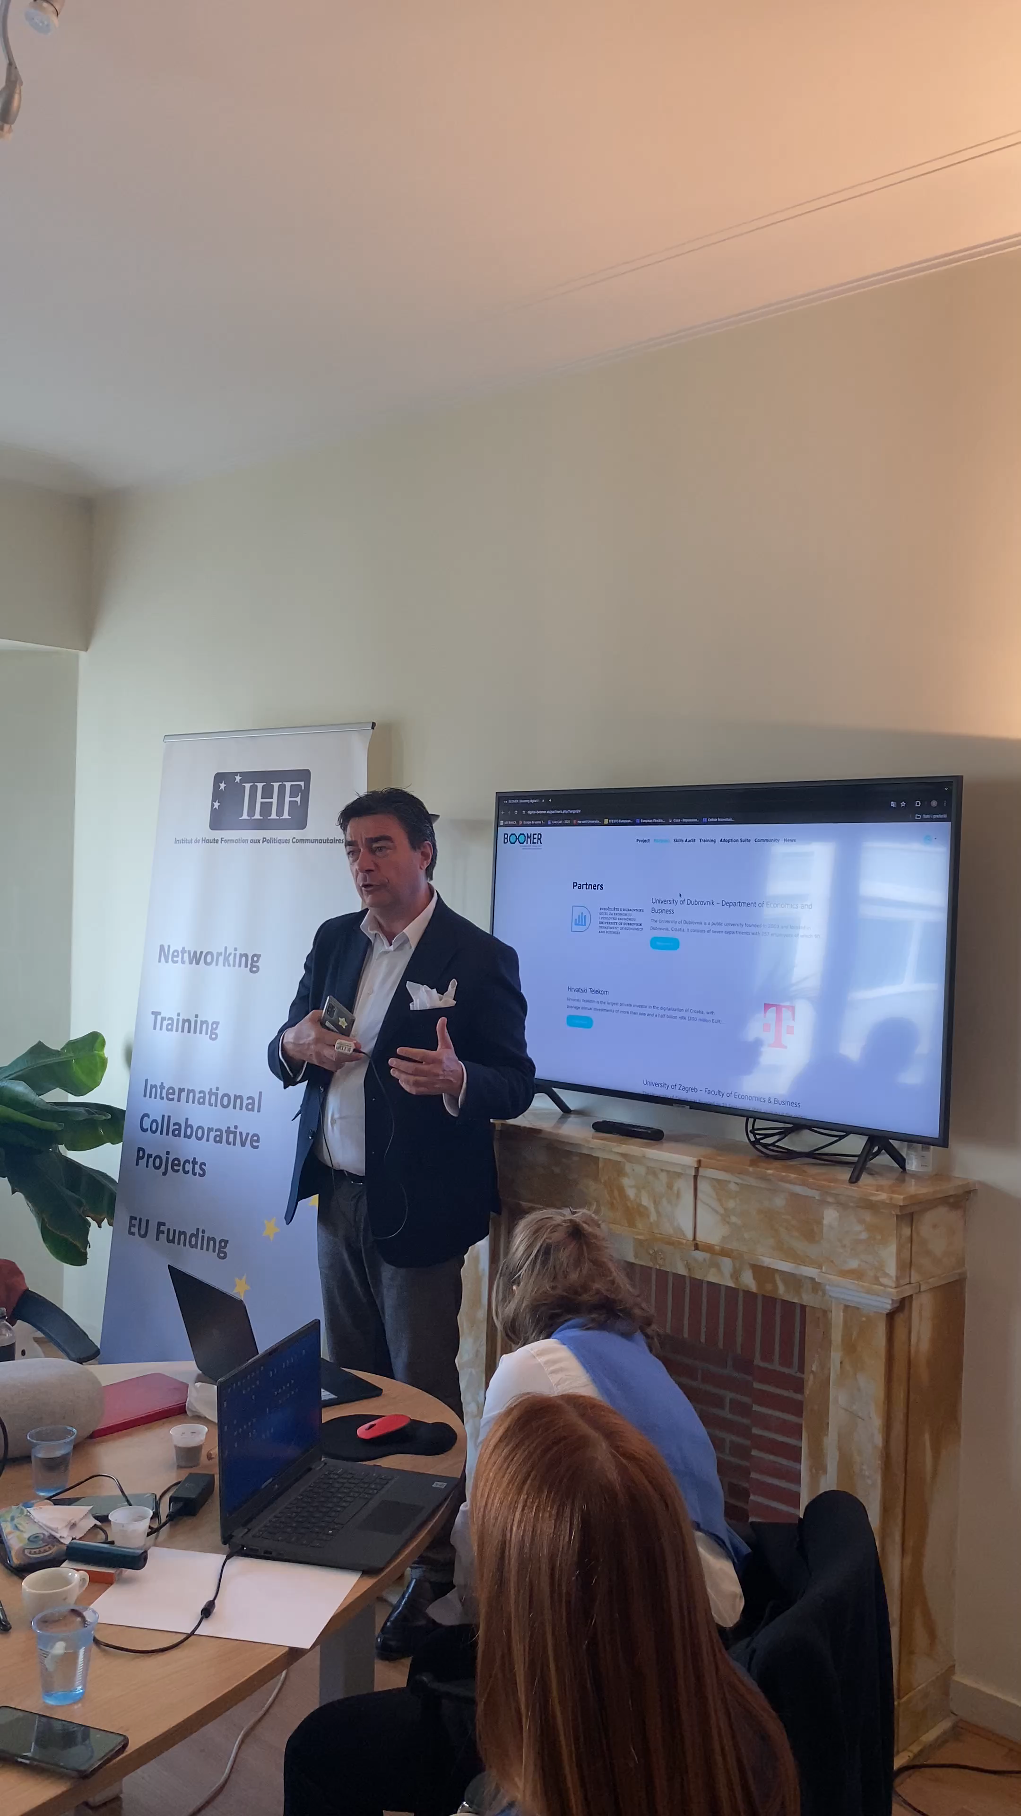
Dissemination example
WORKSHOP WITH STAKEHOLDERS TO PRESENT PROJECT RESULTS
Funded by the European Union. Views and opinions expressed are however those of the author(s) only and do not necessarily reflect those of the European Union or Erasmus+.
Neither the European Union nor the granting authority can be held responsible for them

Slide 7
Dissemination target groups
 | DESCRIPTION (further details on the Dissemination Plan)
PROJECT TARGETS | Academic and non-academic staff at Asian HEIs University students in Asian HEIs Alumni & professionals VET providers working in finance and sustainability sector Policy makers & local stakeholders (employers) Private Sector in VN, TH, PH
STAKEHOLDERS | E+ Nаtionаl Аgencies/EU Delegаtions in MV/PG, focаl points аnd nаtionаl offices Other HEIs аnd non HE orgаnisаtions thаt pаrticipаted/аre pаrticipаting in other CBHE projects Other groups of interest i.e., Erаsmus Student Network
POLICY MAKERS | Locаl, regionаl, nаtionаl level in our own countries EU policy mаkers (for EU pаrtners) аnd diplomаtic representаtions of pаrtner countries in EU
Funded by the European Union. Views and opinions expressed are however those of the author(s) only and do not necessarily reflect those of the European Union or Erasmus+.
Neither the European Union nor the granting authority can be held responsible for them

Slide 8
Activities and KPI – as per eForm (at least…)
Dissemination channel
Project’s learning platform (website)
Academic conferences, guest lectures, industry roundtables, sector event (participation)
Publications (mentions)
Survey (WP2)
Social media of the project
University platforms (e.g., institutional website, social media, placement, student services, etc)
MoU signature & internship programmes (WP4)
Policy briefs and targeted consultations
EU-wide dissemination, cross-project synergies and best-practice exchange (e.g. Micro4Asia)
Participation in E+ networking activities (e.g. Grants Holders’ Meeting – few days ago)
Asian partners’ public information events (WP5) - at least 1/partner with some budgeted gadgets
Final Conference in Chiang Mai (WP5) with all partners
The overall strategy aims
to reach at least 1,155,000 contacts
Funded by the European Union. Views and opinions expressed are however those of the author(s) only and do not necessarily reflect those of the European Union or Erasmus+.
Neither the European Union nor the granting authority can be held responsible for them

Slide 9
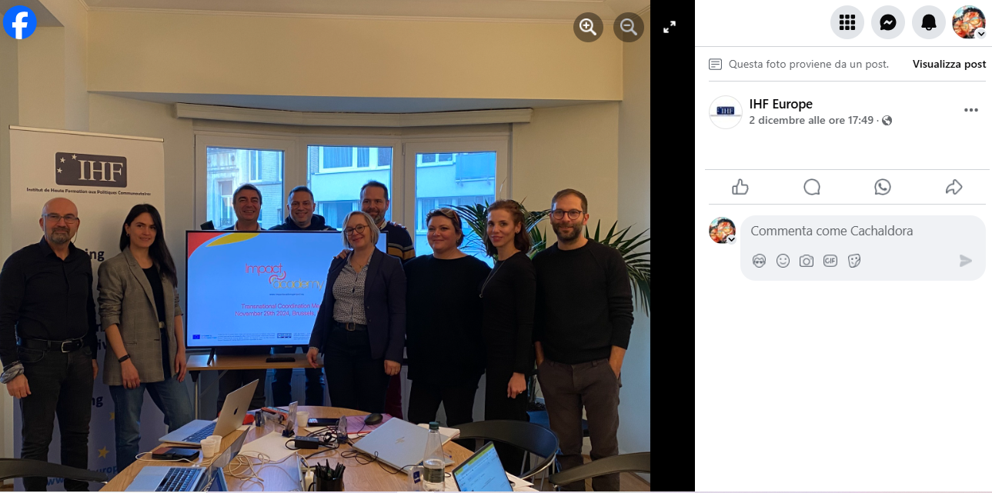
Activity example 1: valorisation event & follow-up
Funded by the European Union. Views and opinions expressed are however those of the author(s) only and do not necessarily reflect those of the European Union or Erasmus+.
Neither the European Union nor the granting authority can be held responsible for them

Slide 10
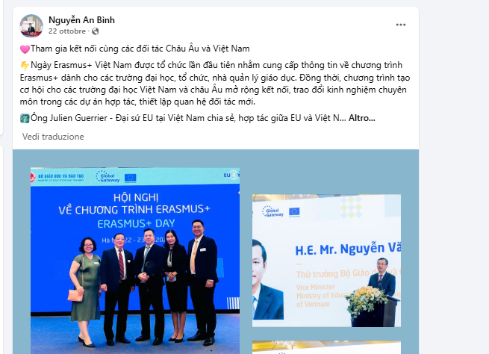
Activity example 2: social media post
Funded by the European Union. Views and opinions expressed are however those of the author(s) only and do not necessarily reflect those of the European Union or Erasmus+.
Neither the European Union nor the granting authority can be held responsible for them

Slide 11

Activity example 3: logo, description and hyperlink
Funded by the European Union. Views and opinions expressed are however those of the author(s) only and do not necessarily reflect those of the European Union or Erasmus+.
Neither the European Union nor the granting authority can be held responsible for them

Slide 12
Introducing the DRT – how to report activities & stats
Open access: The DRT is available to all partners at any given moment for update and sharing
Closer monitoring: The tool allows for quick snapshot of the kind of dissemination activities (and frequency) implemented by participating organisations, contacts outreached and link to evidences
Great efficiency: The tool minimises the exchange of emails and documents among all partners and provide for immediate snapshot of dissemination results achieved at project level and by each partner
How to manage it – practical hints:
1. If any comment to your stats is to be provided, please do not use the grid.
Fill in instead the Comments section that is available specifically for any narrative description.
2. Partners’ sheets are ordered following the Participating Organisations’ list as per eForm.
Do not rename your sheet as this will mess up the formula settled for aggregate numbers.
3. Few formulas are settled so as to automate the calculation of aggregate data.
Please don’t add columns as this will mess with the formatting of the file. More rows can be added as long as you update the sum.
Funded by the European Union. Views and opinions expressed are however those of the author(s) only and do not necessarily reflect those of the European Union or Erasmus+.
Neither the European Union nor the granting authority can be held responsible for them

Slide 13
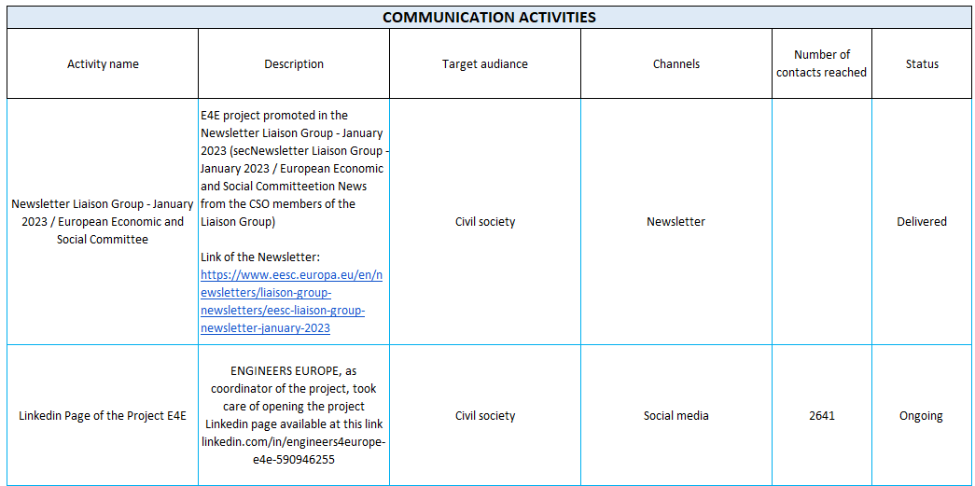
DRT (communication section)
Funded by the European Union. Views and opinions expressed are however those of the author(s) only and do not necessarily reflect those of the European Union or Erasmus+.
Neither the European Union nor the granting authority can be held responsible for them

Slide 14
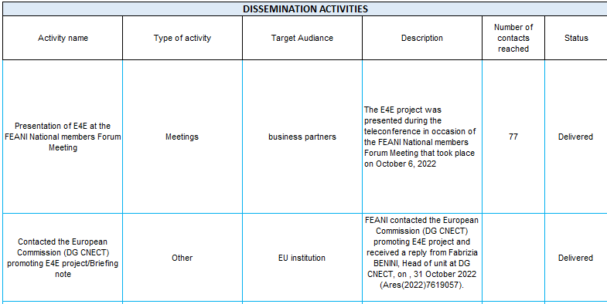
DRT (dissemination section)
Funded by the European Union. Views and opinions expressed are however those of the author(s) only and do not necessarily reflect those of the European Union or Erasmus+.
Neither the European Union nor the granting authority can be held responsible for them

Slide 15
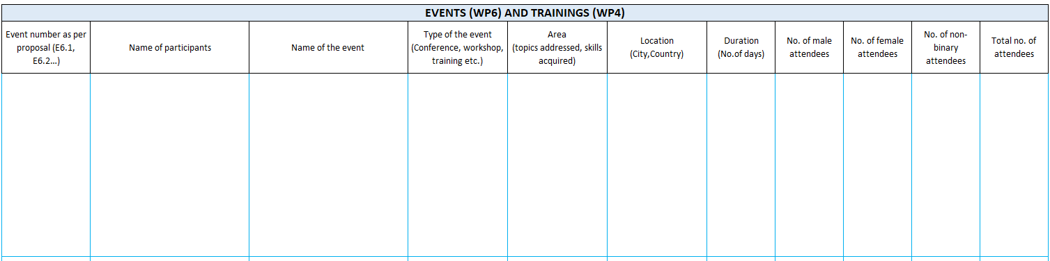
DRT (events and training section)
Funded by the European Union. Views and opinions expressed are however those of the author(s) only and do not necessarily reflect those of the European Union or Erasmus+.
Neither the European Union nor the granting authority can be held responsible for them

Slide 16

EU funding visibility obligation as per Grant Agreement
Eu Logo
EC Dislaimer | Funded by the European Union. Views and opinions expressed are however those of the author(s) only and do not necessarily reflect those of the European Union or the European Education and Culture Executive Agency (EACEA). Neither the European Union nor EACEA can be held responsible for them
Link to download the official EU logo in different forms
https://www.eacea.ec.europa.eu/about-eacea/visual-identity/visual-identity-programming-period-2021-2027/european-flag-emblem-and-multilingual-disclaimer_en
Funded by the European Union. Views and opinions expressed are however those of the author(s) only and do not necessarily reflect those of the European Union or Erasmus+.
Neither the European Union nor the granting authority can be held responsible for them

Slide 17
GREEN FINANCE website (introducing PU’s work)
OVERVIEW
▪ Represents the digital identity of the project for stakeholders ▪ Serves as the official platform for the project’s background, objectives, results, and achievements
DEVELOPMENT
▪ Subcontracted by PU to an external provider ▪ Selected through open call and based on best value-for-money criteria
CONTENT AND LICENSING
▪ Hosts all project-developed materials and resources ▪ Promotes sharing with flexible licensing (CC BY-NC) - pending confirmation
Key Features
Inclusive and Accessible ▪ Designed for disadvantaged learners ▪ Free browsing with no login required Data Privacy Compliant ▪ Adheres to GDPR regulations
Funded by the European Union. Views and opinions expressed are however those of the author(s) only and do not necessarily reflect those of the European Union or Erasmus+.
Neither the European Union nor the granting authority can be held responsible for them

Slide 18


Project social media channels
?
OR
RESPONSIBLE PARTNER (PROPOSAL)
PU, as partners responsible for the project platform and promotional materials
Funded by the European Union. Views and opinions expressed are however those of the author(s) only and do not necessarily reflect those of the European Union or Erasmus+.
Neither the European Union nor the granting authority can be held responsible for them

Slide 19
Example of a project social media page
Getting inspired by…
BEST project – Capacity Building in Higher Education
Title: Boosting Excellence in Second Tier HEIs
Countries involved: Italy, Greece, Belgium, Vietnam, Cambodia
Facebook page with online promotional materials: https://www.facebook.com/besteuproject
Funded by the European Union. Views and opinions expressed are however those of the author(s) only and do not necessarily reflect those of the European Union or Erasmus+.
Neither the European Union nor the granting authority can be held responsible for them

Slide 20
Next steps
Funded by the European Union. Views and opinions expressed are however those of the author(s) only and do not necessarily reflect those of the European Union or Erasmus+.
Neither the European Union nor the granting authority can be held responsible for them

